Slide 1
Research Update: Multifidelity likelihood estimation and accelerated sampling for posteriors of force field parameters
Bryce Manubay
Date: 11/14/17

Slide 2
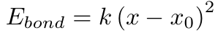
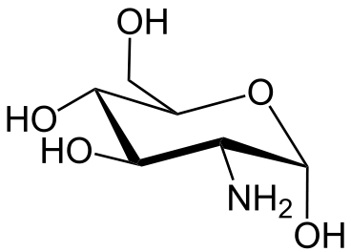
What do force fields do?
Force fields give the potential energy of a spatial configuration
Generally 3 major parts:
Functional form: equations for calculating potential energy
Parameters
Atom types
Notes:
Atom types: shrink parameter space to reduce interaction and avoid over-fitting
Parameters: associated with one or many atom types, determine the magnitude of the interactions in the system
Maybe consider taking out discussion of atom types

Slide 3
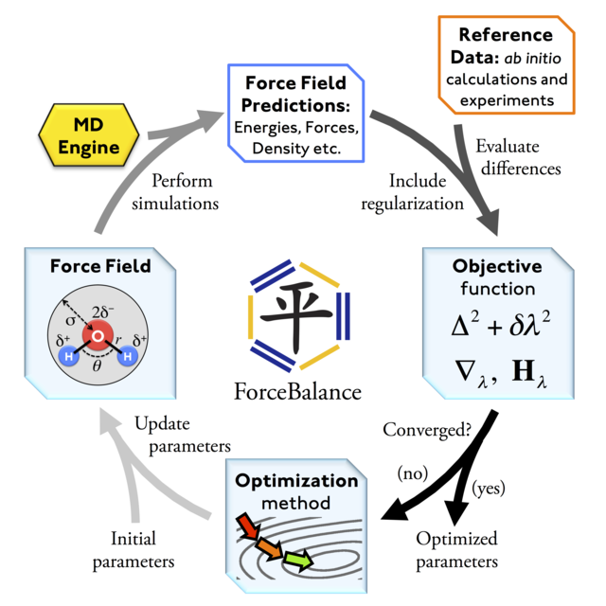
Current force field parameterization is inefficient and heuristic
Force field parameterization methods often require human intervention to optimize
Ex: Amber parm94
Manually parameterized
Atom types selected by expert chemists
Sophisticated methods still require human intervention
Ex: ForceBalance
Minimization of objective function still require human assigned weight for different kinds of fitting data
¹ Cornell et al. J. Am. Chem. Soc., vol. 117, no. 19, pp. 5179–5197, 1995.
² Wang et al. J. Phys. Chem. Lett., vol. 5, no. 11, pp. 1885–1891, 2014
Notes:
Parm94 – entire thing was manually parametrized with atom types thought up by chemical experts

Slide 4
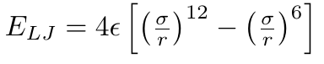
Functional forms are often not physically justified
Common functional forms of interactions are NOT physically justified. Example:
Approximates Pauli repulsion and scales with r⁻¹² for efficiency of computing as (r⁻⁶)²
Attractive term physically motivated by the form of VdW and dispersion forces
Notes:
Be more precise of why it hasn’t changed
Last bullet point is separate thesis
Start it on separate slides
Be a little more precise on why not changing
Need to change everything

Slide 5
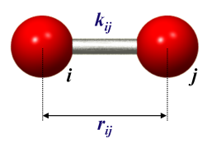
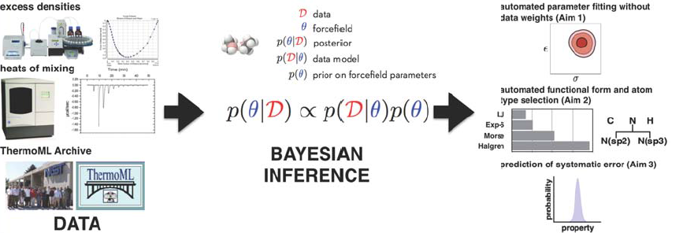
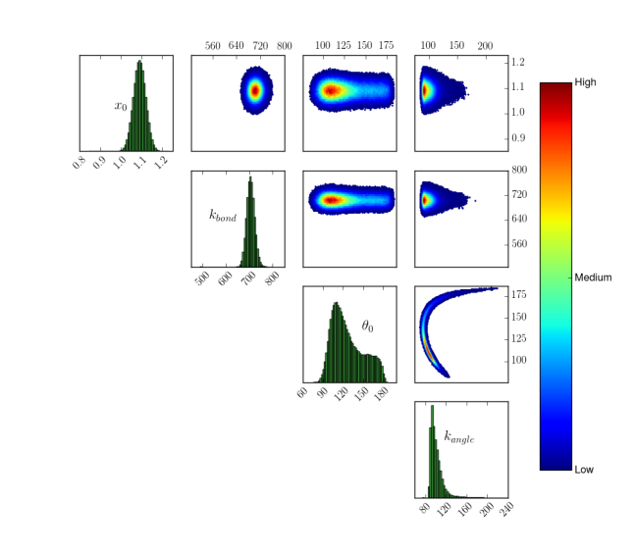
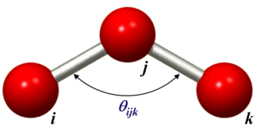

Bayesian inference to parameterize MD force fields
Appropriate models and associated parameters can be inferred from data
¹ Shirts and Chodera, TPI 7609250, 2015.
Notes:
Using hypothesized parameter set, we simulate the evidence to, in combination with uncertainty in evidence, assess the “likelihood” function
Bayesian inference can utilize an informationless prior or the previous posterior to “update” the inference (“posterior” → “prior”)
Sample posterior to determine families of parameter sets based on their relative probability (process easily iterated to improve consistency of hypothesis
Make sure keywords are consistent
Say same thing as previous in terms of experimental data provided
Better figures
Sum up everything more succinctly in the figure

Slide 6
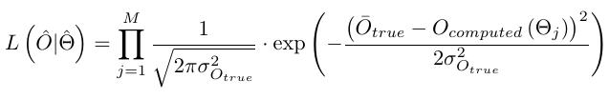
Posterior sampling requires repeated evaluation of a likelihood function
Likelihood function requires us to compute observables as a function of parameters we wish to sample
O is an observable, ϴ_{j} is a parameter set, σ_{O}² is variance associated with the evidence, ‘true’ indicates data used as evidence and ‘computed’ indicates a computed quantity
Want cheap analytical method to compute observables as function of parameter

Slide 7
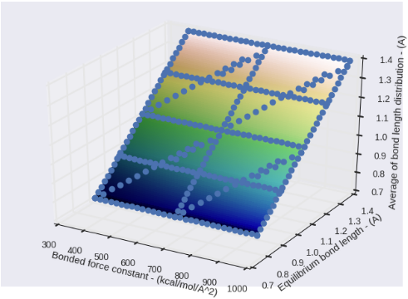
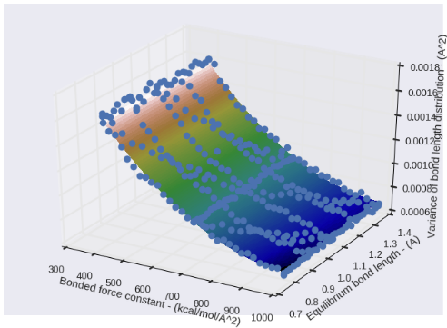
Bonded observables are a simple analytical fit of k_{bond} and x₀
Average bond length and bond length variance were fit with a quadratic polynomial surface across a large range of k_{bond} and x₀ using LLS
Points are from calculated observables from full simulation

Slide 8
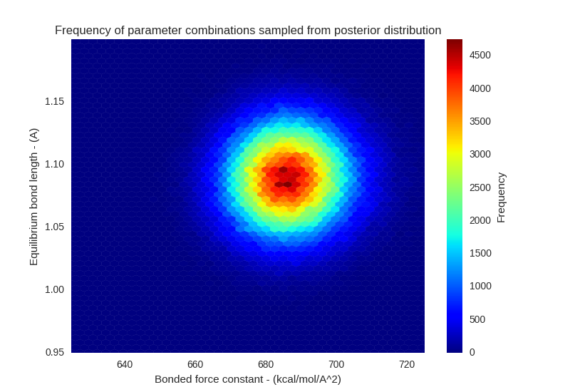
Posterior distributions can be rapidly sampled using these analytical models
Took ~1 hr to make 10⁶ realizations of the posterior using the analytical observable models
Would have taken about that long to complete 1 of the simulations that were used to construct the models
Notes:
How does probability change depending on types of data we introduce?
Information loss
Might consider adding algorithm to explain sampling process
This posterior shows what range of parameters we really care to fit over
(5-10 % change from evidence)

Slide 9

Correlation may exist between parameters

Slide 10
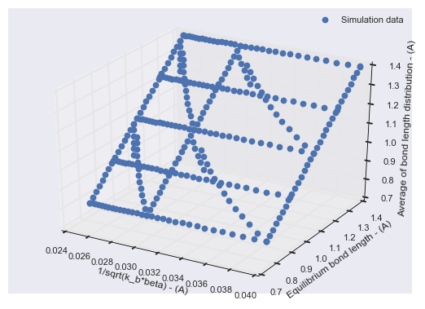
Calculation of the likelihood, specifically observables, is done at 3 levels of rigor
Highest level: direct calculation of observables from classical mechanics simulation

Slide 11
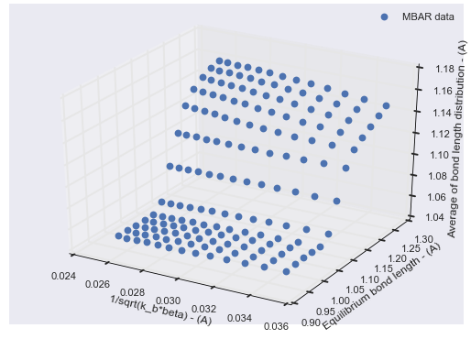
Calculation of the likelihood, specifically observables, is done at 3 levels of rigor
Mid level: estimation of observables at unknown parameter states from known states by MBAR

Slide 12
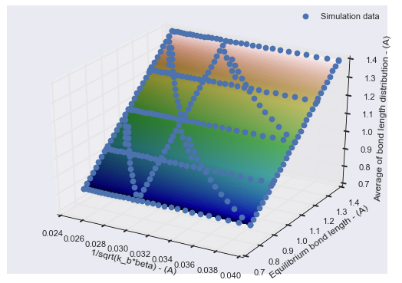
Calculation of the likelihood, specifically observables, is done at 3 levels of rigor
Lowest level: estimation of observables by surrogate models fit to simulated data

Slide 13

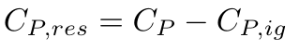
We are testing the multifidelity method by refitting a small number of LJ parameters
Which parameters are we refitting?
`epsilon` and `rmin_half` associated with the [#6X4:1] SMIRKS type to start with
Which molecules are we using?
We’re verifying the method, so starting with just a single molecule
What observables are we fitting to?
Molar volume and residual heat capacity, where:

Slide 14
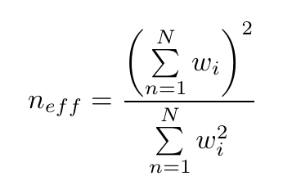
The reliability of MBAR estimates is correlated to the effective sample number
Effective sample number is, essentially, an estimate of how many samples are contributing to the average at a given state and is given by:
Work by a collaborator at NIST suggests that with an N_eff > ~50, predictions from MBAR have good parity to calculations made with full MD
Running simulations to construct parity and deviation plots to confirm for my own system

Slide 15
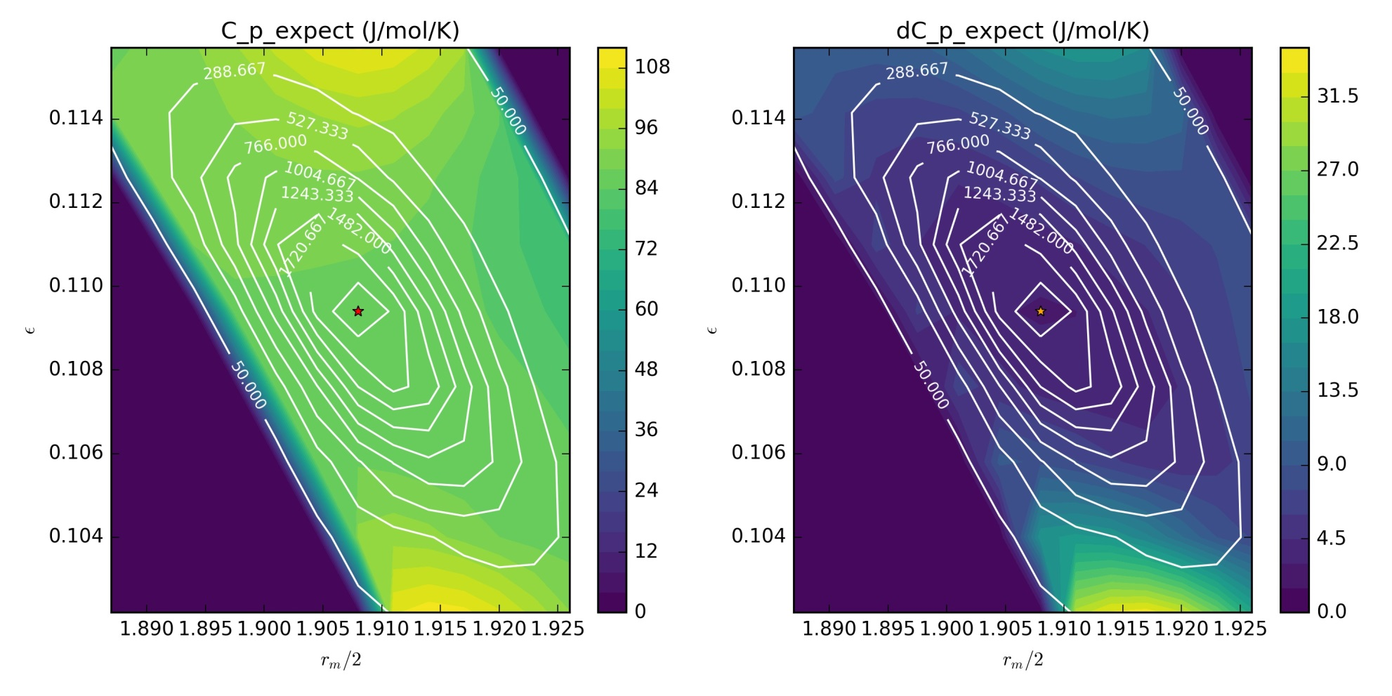
MBAR estimates of uncertainty are not reliable when compared to bootstrapping
** White contours show number of effective samples

Slide 16
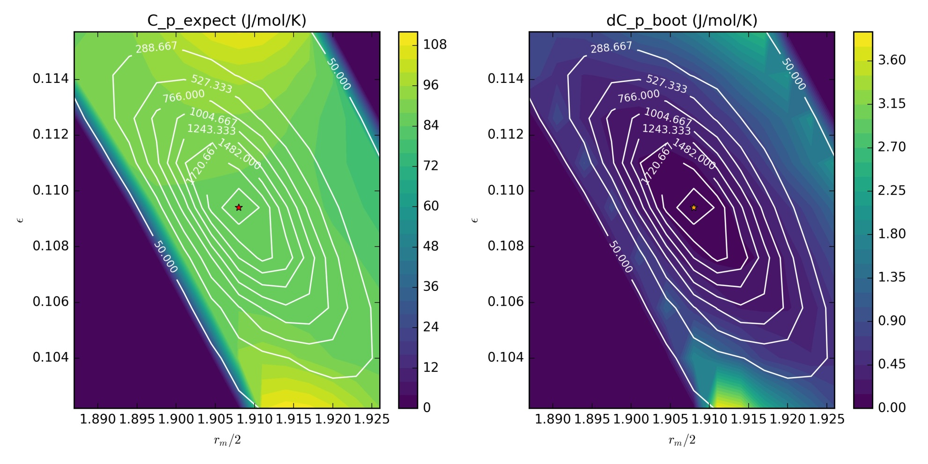
MBAR estimates of uncertainty are not reliable when compared to bootstrapping
** White contours show number of effective samples

Slide 17
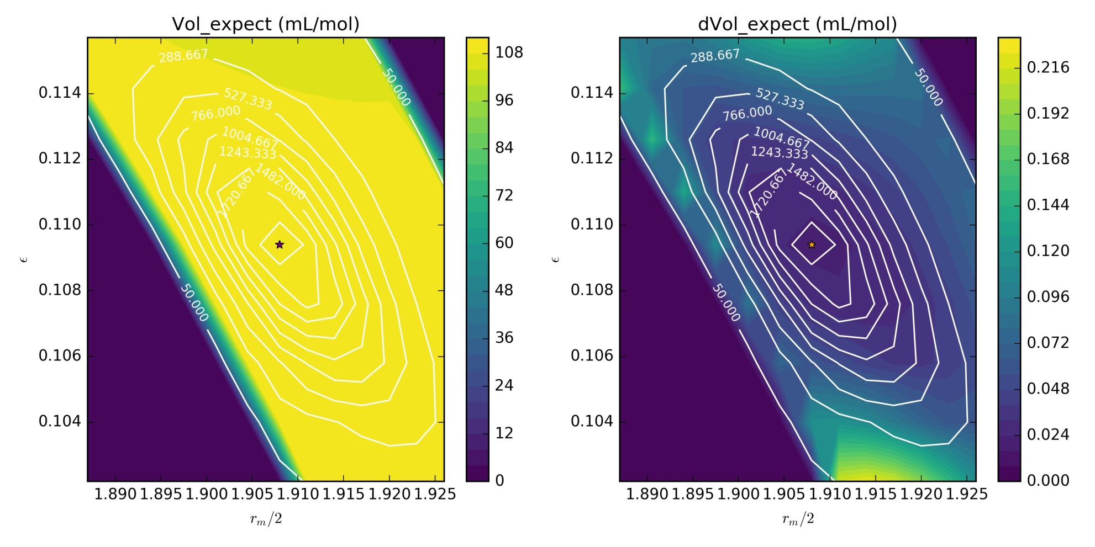
MBAR estimates of uncertainty are not reliable when compared to bootstrapping
** White contours show number of effective samples

Slide 18
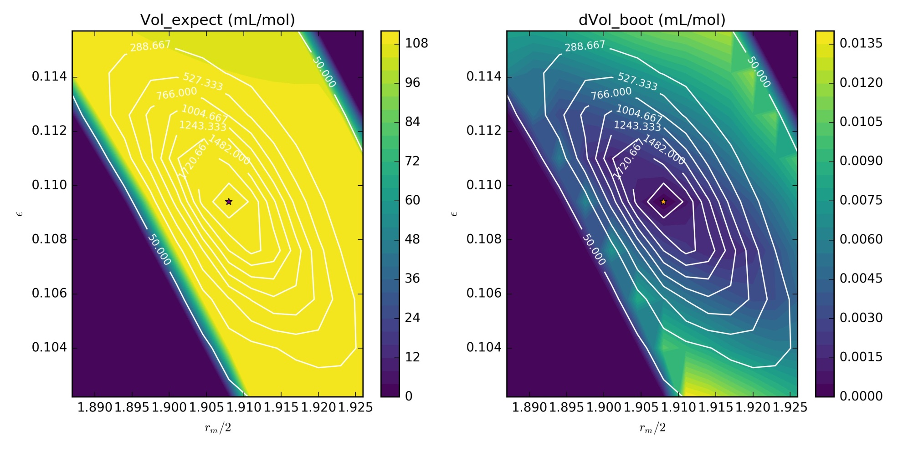
MBAR estimates of uncertainty are not reliable when compared to bootstrapping
** White contours show number of effective samples

Slide 19
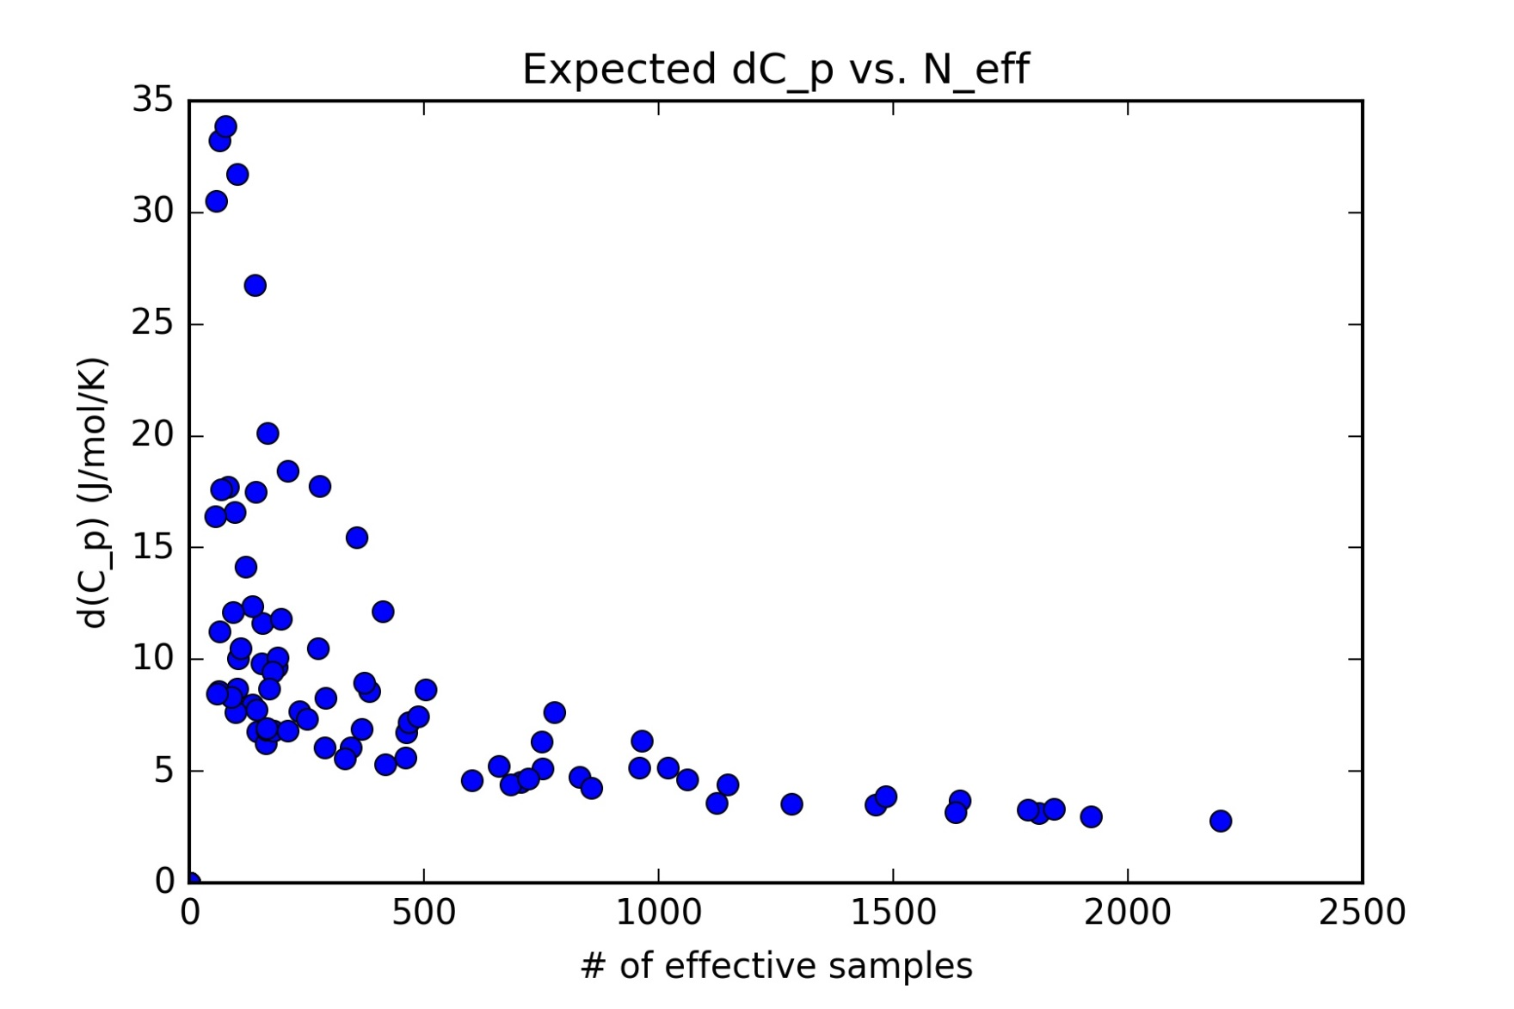
Expectation and bootstrap calculations of uncertainty are strong functions of N_eff
Notes:
/ by N for expectation calculations → uncertainty of single molecule

Slide 20
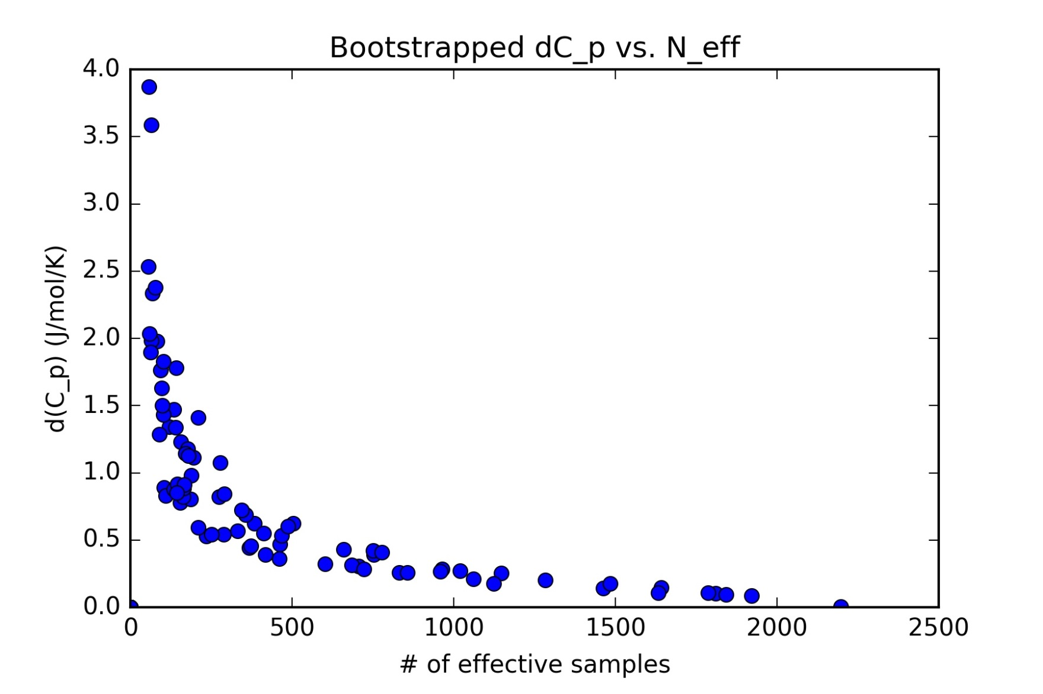
Expectation and bootstrap calculations of uncertainty are strong functions of N_eff

Slide 21
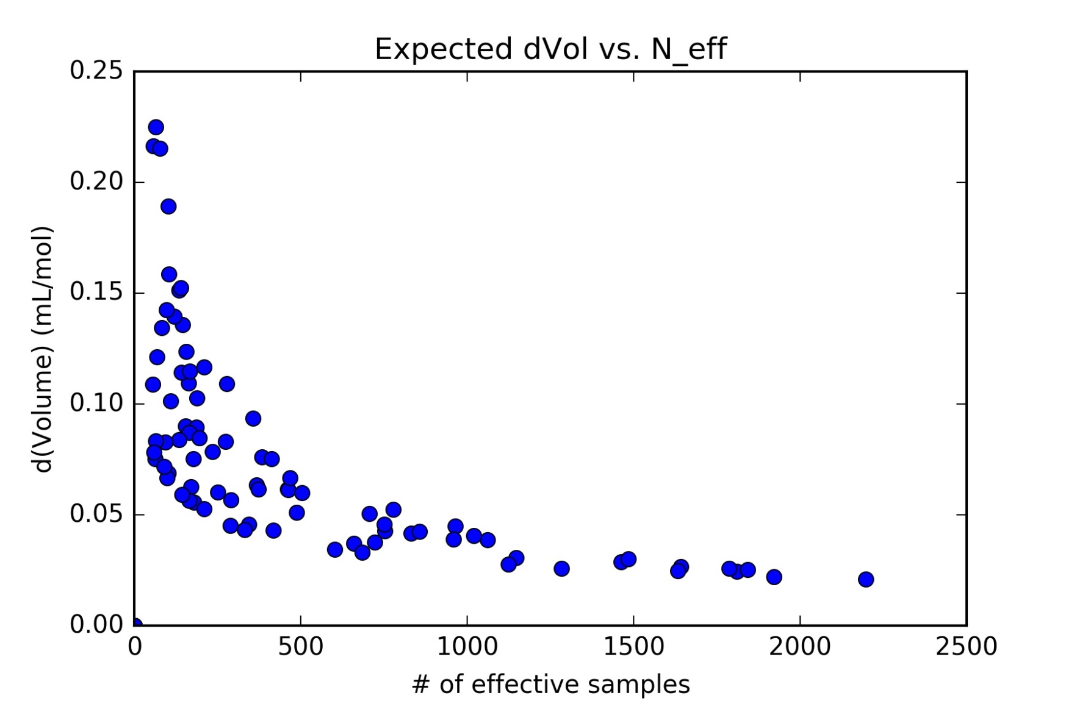
Expectation and bootstrap calculations of uncertainty are strong functions of N_eff

Slide 22
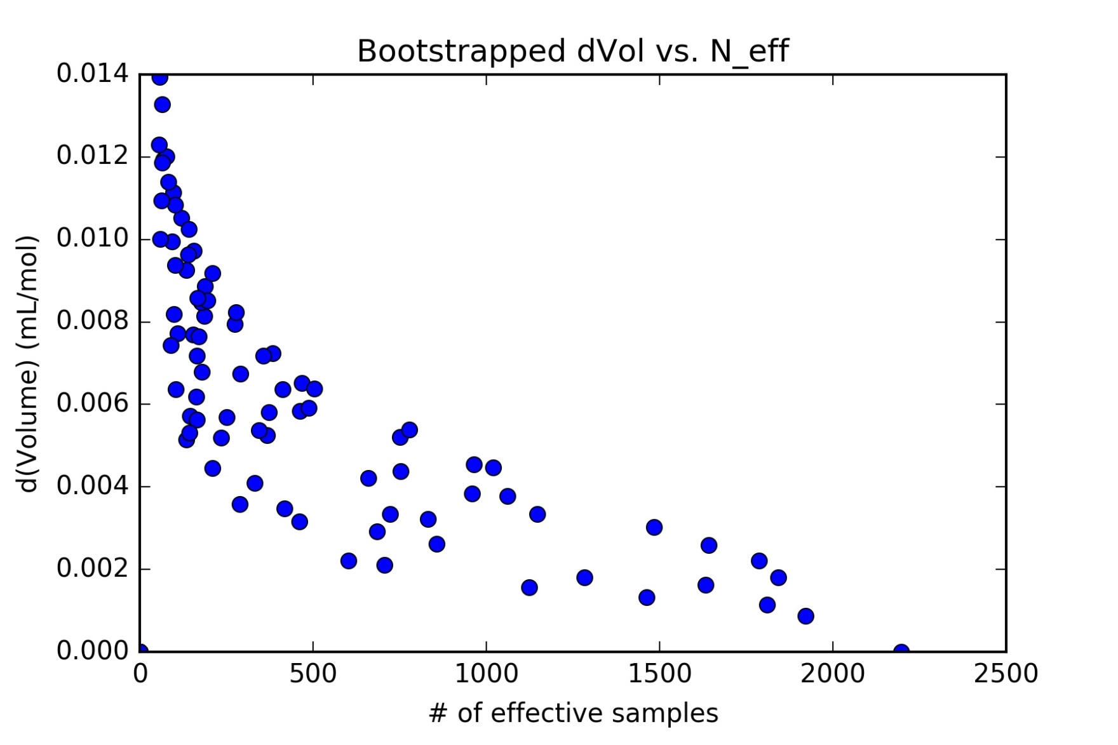
Expectation and bootstrap calculations of uncertainty are strong functions of N_eff

Slide 23
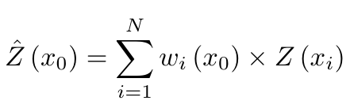
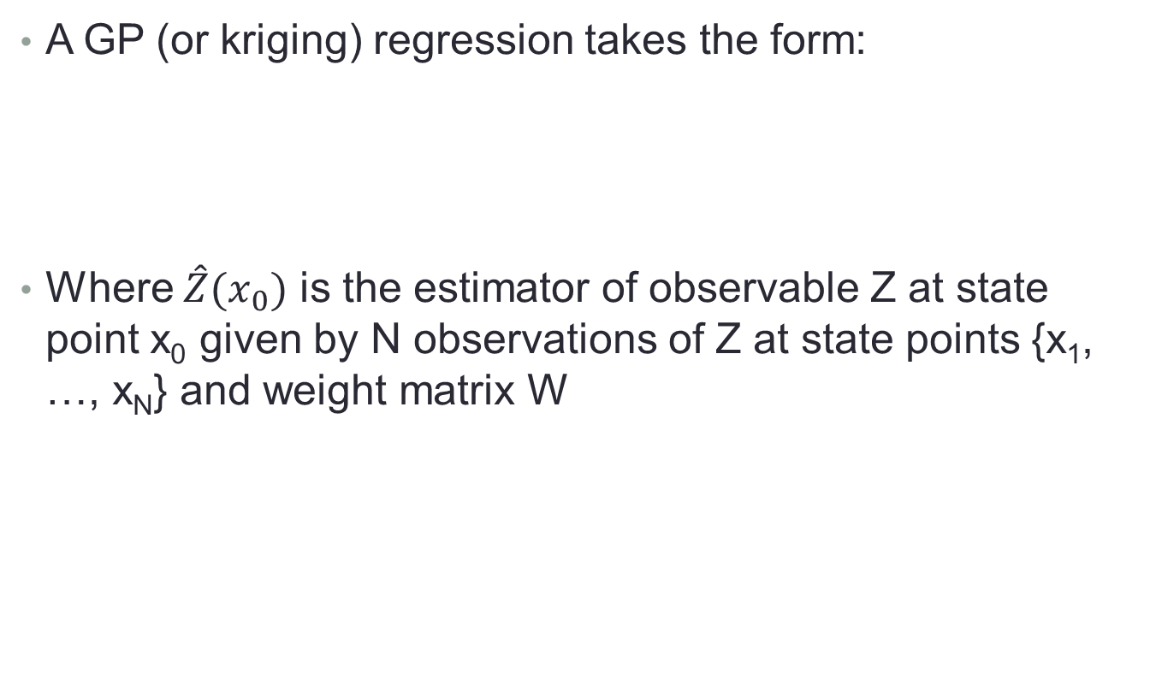
We can make accurate, multidimensional models with gaussian process regression
A GP (or kriging) regression takes the form:
Where $\hat{Z}{(x}_{0})$ is the estimator of observable Z at state point x₀ given by N observations of Z at state points {x₁, …, x_{N}} and weight matrix W

Slide 24
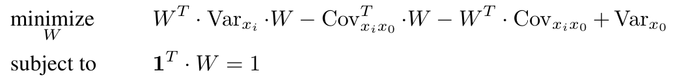
More on GP regression
W is given by the following system of equations:
The weights reflect the structural closeness of samples to the estimation location and have a desegregating effect, to avoid bias caused by sample clustering
A collaborator at MSKCC has a lot of expertise on GP regression and we’re currently working to prototype the multifidelity sampling process

Slide 25

Acknowledgements
Special thanks to:
Chodera Group @ MSKCC
Mobley Group @ UCI
Chris Bayly @ OpenEye Software
The rest of the OpenFF consortium

Slide 26
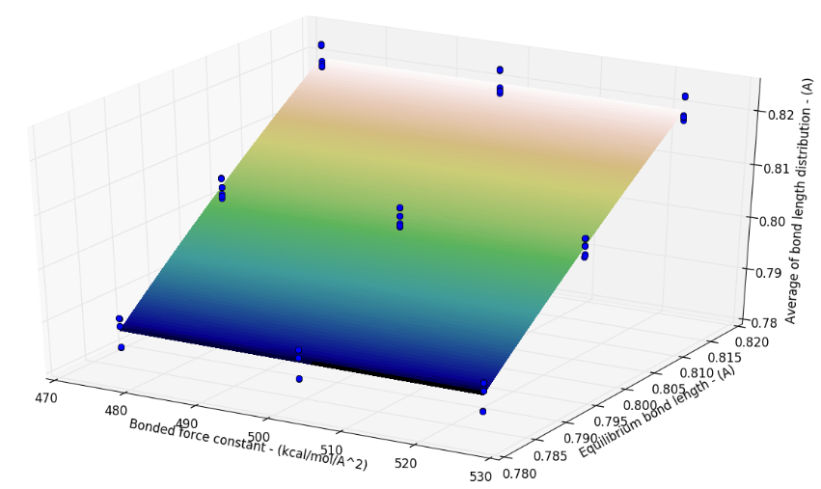
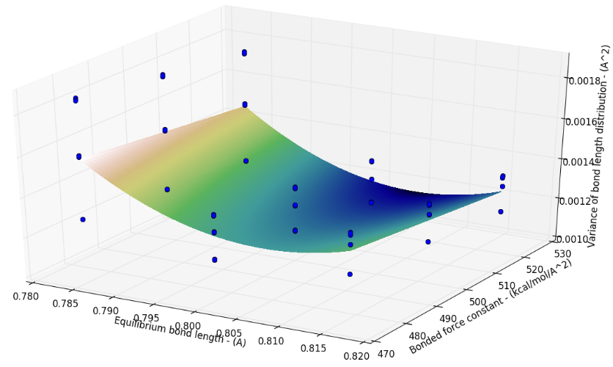
Local models can be constructed using observable data calculated with MBAR
MBAR results give an at least qualitatively similar fit (I haven’t gotten around to testing them while sampling yet)
Note that the models just need to be good enough to bring us close to the “interesting regions” of our posterior

Slide 27
We can use the locally accurate surrogate models to find high probability regions
Use those surrogate models in the MCMC in order to perform Bayesian inference
Once sampling has converged for the initial model, perform another simulation, make a new model and repeat until the state is stationary
Have a few loose, mostly heuristic, ideas to see if sampling has converged, but would love some suggestions!!!

Slide 28
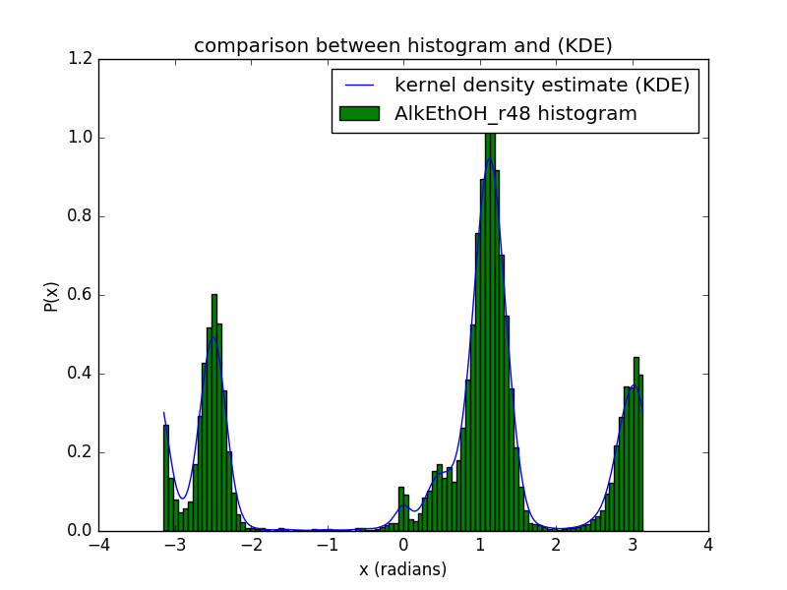
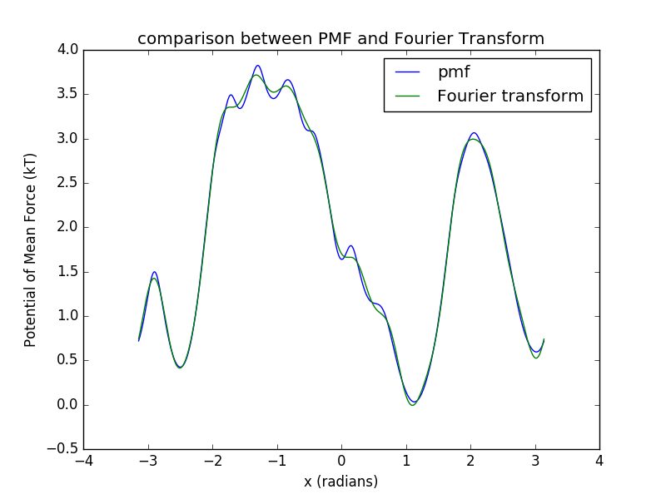
Fitting to potential of mean force could be usable for torsion observables
Smooth histogram of torsion angles using a KDE and calcluate the PMF using that KDE
Make LLS fit of the Fourier series in order to get out coefficients (to be observables)
Coefficients were found to be uncorrelated (which will help keep likelihood evaluation simple)

Slide 29
3 bond j-couplings as observable to constrain dihedral parameters
More physically motivated than what we had previously been thinking
Something that can be carried over to next parameterization project (general liquid organics, neat and mixtures)

Slide 30
Simulation could be minimized by use of MBAR and surrogate modelling
Rather than simulating every proposed state, it may be possible to use both MBAR and surrogate modelling to accelerate sampling
Basic Idea:
Simulate our initial state and calculate our observables
Extend knowledge of observables in local parameter space and use that observable data to construct surrogate models

Slide 31
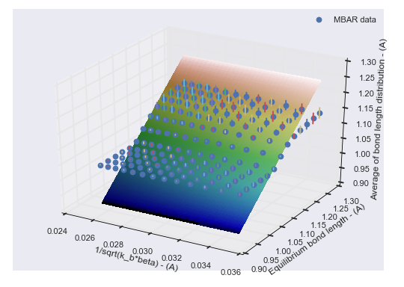
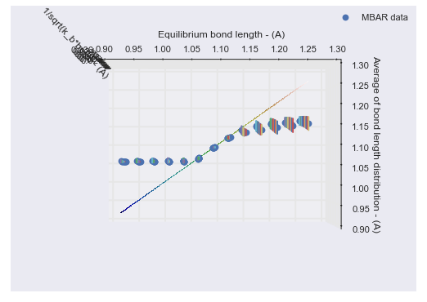
MBAR may have limited applicability for property calculation
Found MBAR reweighted bond length averages have very little dependence on force constant
Can make ~5% changes in bond length and still retain an accurate estimate

Slide 32
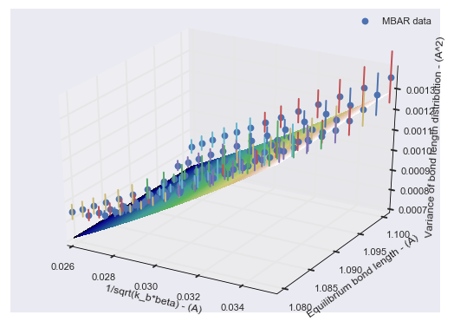
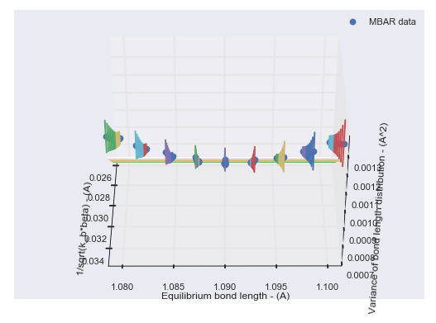
Bond length variance has a surprisingly strong dependence on x₀
MBAR reweighted bond length variance has a similar dependence on k_{bond} as the simulated equivalent
There is a surprisingly strong dependence on x₀ such that we can only make ~0.5% changes in x₀ and retain accuracy

Slide 33
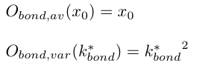
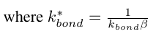
Theoretical models made by dimensional analysis of force field parameters
Simple theoretical models can be made by making a dimensional analysis of force field parameters
Observe the equilibrium bond length has units of angstroms
A simple transformation of k_{bond} brings about k*_{bond} which has units of angstroms as well

Slide 34
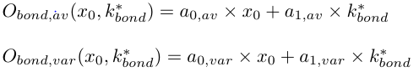
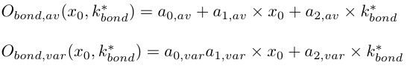
Which model forms should we be using for the surrogates?
Other simple surrogate models, up to a quadratic polynomial surface, are being tested
Two parameter linear model
Linear model with intercept

Slide 35
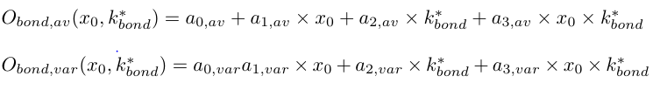
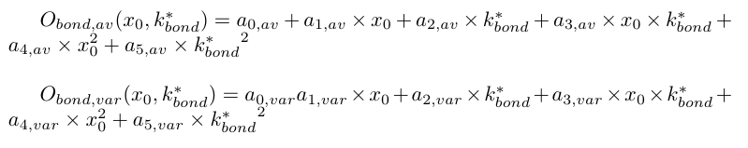
Which model forms should we be using for the surrogates?
Linear model with intercept and cross-term
Quadratic polynomial surface model

Slide 36
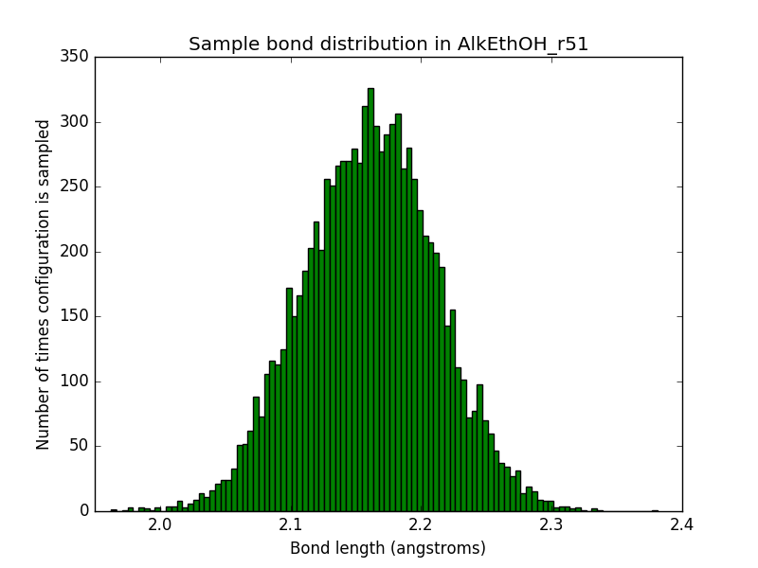
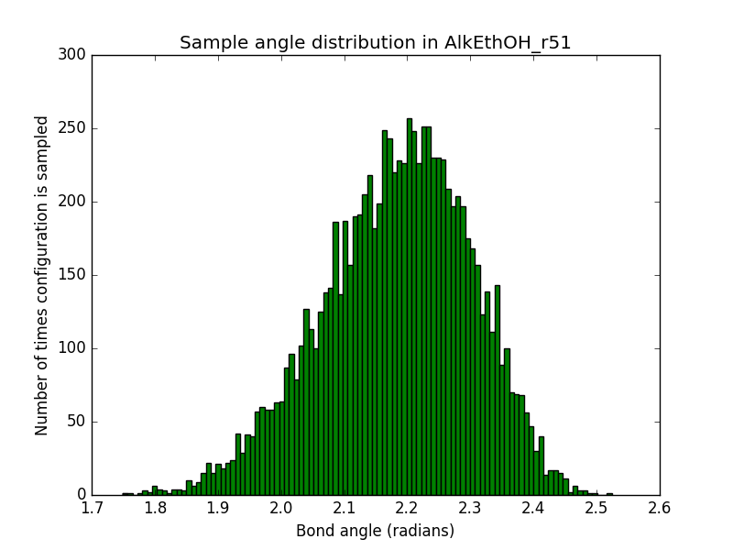
We will use single molecule simulations to parameterize to and test Bayesian machinery
Test:
1. Parameters θ produce bond, angle and torsion evidence
2. Evidence:
Bonds and angles:
Distribution means
Distribution variances
1.0 1.1 1.2
Bond Length (angstroms)
1.6 1.7 1.8
Bond Angle (radians)
Notes:
What are observables
Mean and spread
Separate slide on how we can tell if the bayesian process was successful
Relabel

Slide 37
We will use single molecule simulations to parameterize to and test Bayesian machinery (cont.)
Torsions:
A little more complicated
Distributions not always Gaussian
3. Perturb original parameters
Change to new force field θ*
4. Recover original force field

Slide 38
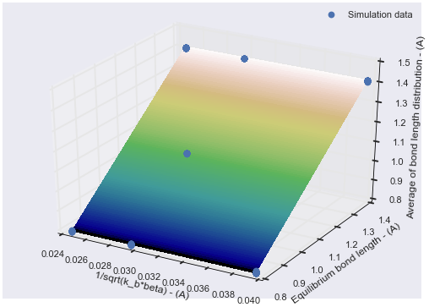
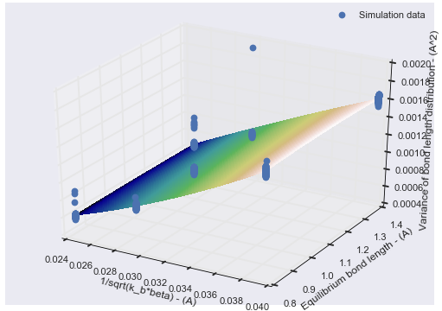
Cheaper, less accurate surrogate models can be constructed with fewer simulations
The two previous, very good surrogate models were constructed from ~260 simulation points
Can we use less accurate surrogate models, made from far fewer simulations, to accelerate posterior sampling?
Notes:
Sigma away of 5 point fit to 260 point fit
Shrink space over

Slide 39
Surrogate models made from so few simulations points not accurate enough
Initial tests of using these surrogates for MCMC sampling gives no results
Using these surrogates often results in likelihood function values of 0
Meaning proposed moves never get accepted
Thoughts on improvement
Expand data to fit over using MBAR
Increase number of simulated points to fit over (only used 5 different parameter states for the models on the previous slide)
Notes:
Logarithm of likelihood (check that)
Number of points for fitting over be some optimization problem?

Slide 40
The posterior of parameter probabilities can be sampled using MCMC
Basic Algorithm:
Gather evidence using original force field and then perform a set of simulations given a different set of force field parameter and a list of molecules
From these simulations, calculate the observables associated with the parameters being changed (i.e. if changing a bond SMIRKS type → bond length average and variance)
Propose a move in parameter space and compute those same set of observables at that new parameter state. We could do this by making a new simulation or constructing a surrogate model for O(ϴ)
Evaluate likelihood function using computed observables and previously gathered evidence
Accept or reject proposed move based on Metropolis-Hastings criteria

Slide 41
We can sample from the posterior of force field parameters using MCMC
MCMC Specifics:
Set initial parameters, ϴ_{init}, and proposal width, w_{prop}
Set current parameters, ϴ_{curr}, equal to ϴ_{init}
Randomly sample from N(ϴ_{curr}, w_{prop}) to generate a new proposed parameter state, ϴ_{prop}
Calculate likelihood, L, and prior, P, probabilities for the current and proposed states
If (L_{curr} * P_{curr})/(L_{prop} * P_{prop}) > n ~ U(0,1), then we accept the proposed move, set ϴ_{curr} = ϴ_{prop} and return to step 3

